Slide 1
Application Monitoring
BMC Patrol

Slide 2
BMC Patrol
BMC Patrol is tool of choice for Enterprise wide monitoring at Abbott.
Benefits of Patrol
Easy to configure.
Support team just has to submit a Purple Form.
Directly Integrated with ITSM.
Tickets will be automatically created when configured event is triggered.

Slide 3
Pre-Requisites for BMC Patrol Usage
BMC Patrol Agent Installation
For servers to be monitored through BMC Patrol, BMC Patrol Agent needs to be installed.
For installing BMC Patrol Agent on servers that lacks it, raise an ITSM incident to the Windows Operations team (WIP-GLBL-Windows / VmWare Operations).
Turning on Infrastructure Event
For BMC Patrol to be able to create Incidents in ITSM for an app, Infrastructure event should be turned on.
Raise request through mail to Cognizant’s ITSM SME, Deenadayalan Chandran to turn on the Infrastructure Event.
Details to be provided are the ITSM Product Name and the ITSM Support queue.

Slide 4
Patrol Monitoring Aspects
BMC Patrol can be used for monitoring the below aspects.
Baseline IS Monitoring
File System space Monitoring
Application URL Monitoring
Application Service Monitoring
Windows Event Log Monitoring

Slide 5
Patrol Monitoring Aspects
BMC Patrol can be used for monitoring the below aspects.
Baseline IS Monitoring
File System space Monitoring
Application URL Monitoring
Application Service Monitoring
Windows Event Log Monitoring

Slide 6
Steps for setting up new Monitoring
Make sure that the Prerequisites are already completed for the application.
Update the Purple form with the Request details.
Purple Form is a simple Excel template which has to be filled and submitted as part of Monitoring Request.
Submit the filled out Purple Form through a ITSM ticket to the WIP-GLBL-Tools group.
Please archive copies of submitted Purple form. You would need them if any change to the submitted monitoring is needed.

Slide 7
Sections of Purple Form
Enter the Application or Project Name.
Provide the Support Contact details (Application Support along with Vendor details if any).

Slide 8
Sections of Purple Form
Enter Application specific Challenges, known issues, recovery actions etc., can be blank if none.
Provide ITSM Product Categorization for ticket to be created. Refer categorization in ITSM to provide.
Provide the ITSM Support group and Priority for alert Incidents to be created.

Slide 9
Sections of Purple Form
What to monitor? – Enter the entity that is to be monitored.
Target Server of Device Name – Server on which the monitoring is needed.
Interval – Frequency with which BMC has to check if the monitoring event has been triggered.
Blackout / Maintenance Exception – Time duration when Monitoring is to be paused (Eg: Weekly planned maintenance duration etc)

Slide 10
Sections of Purple Form
ITSM queue to route the ticket – ITSM Support queue for which ticket is to be created for the monitoring event.
Particular Setting and/or recovery – Recovery actions to take if any.
Additional details – Additional info on the monitoring line item. Mention if this is an update to existing monitoring. Also mention Start Date if monitoring has to start only from a specific date.

Slide 11
Sections of Purple Form
ITSM queue to route the ticket – ITSM Support queue for which ticket is to be created for the monitoring event.
Particular Setting and/or recovery – Recovery actions to take if any.
Additional details – Additional info on the monitoring line item. Mention if this is an update to existing monitoring. Also mention Start Date if monitoring has to start only from a specific date.

Slide 12
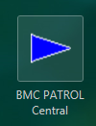
How to access BMC Patrol Central
Raise request in EIDM to get added to the Security group, “APP-GIS-BBPMUsers”
Login to https://apps.oneabbott.com
Click on the BMC Patrol Center Icon.
BMC Patrol Central is a tool for Historical performance information on the Baseline IS parameters.

Slide 13
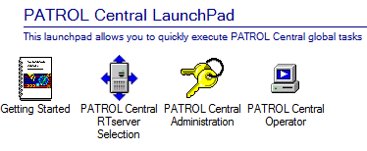
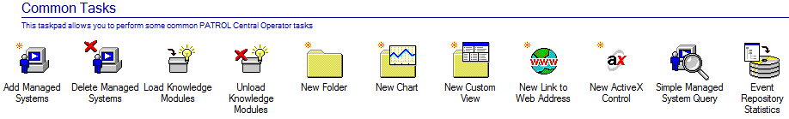
Monitoring on BMC Patrol Central
On BMC Patrol Central Launchpad, click on the Patrol Central Operator.
On the Patrol Central Operator Taskpad, click on Add Managed Systems
Login to https://apps.oneabbott.com

Slide 14
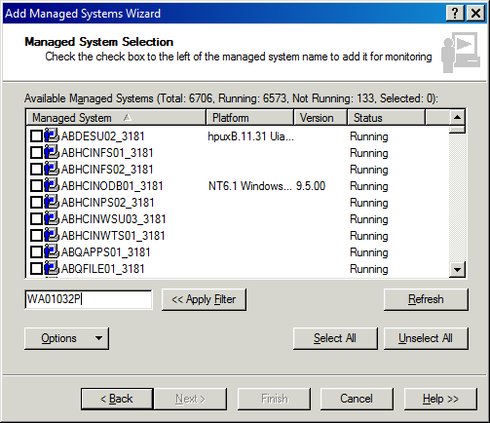
Monitoring on BMC Patrol Central
On Managed Systems Wizard, enter the Server name in the Filter text box and press Enter.
Select the Servers to be monitored and Click on Next.
Click on Finish in the next screen.

Slide 15
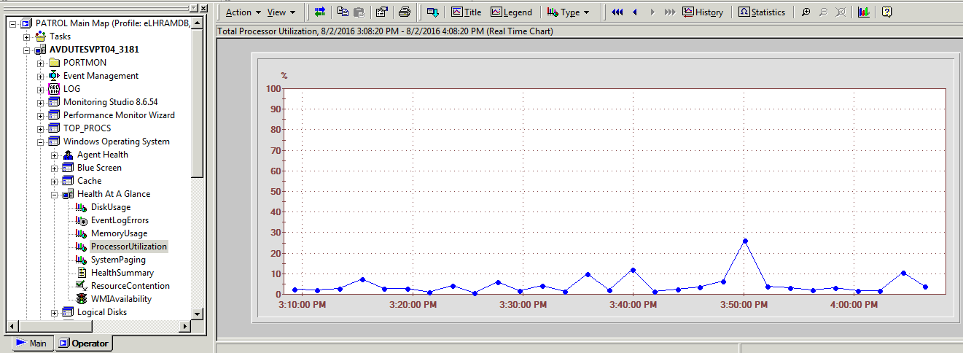
Monitoring on BMC Patrol Central
On the Operator Pane in the left, expand the Server of interest to click the Parameter to check the Performance of.
Real Time Chart of the selected parameter will be shown on the right pane.

